Slide 1


Slide 2

CREATE PhD Stage 1 UK fellowship Applications
Webinar
Wednesday 16th October 2024
12-1pm BST

Slide 3
Panel:
Dr Sean Wasserman (Programme Co-Director) - SGUL
Prof Priscilla Harries (Strategic Advisory Board member) - Kingston University/Hon. Professor SGUL
Drs Josie Prynn and Sarah Sturrock (Current fellow) - KCL /MRC UVRI LSHTM Uganda and SGUL/MRC UVRI LSHTM Uganda
Ms Katherine Barrett (Programme Manager) – LSHTM

Slide 4
Purpose:
Information session about the CREATE PhD Programme - in light of the Stage 1 UK fellowship applications (currently open until 8th November 2024).

Slide 5
Format:
Presentations on the programme and fellowship lifecycle, how to submit a quality application, perspective from a current fellow.
A moderated Q&A

Slide 6
Follow-up:
Please feel welcome to send questions for the panel afterwards via create-phd@lshtm.ac.uk

Slide 7
Housekeeping:
This session will be recorded and will be made available afterwards
Only nominated panelists can be seen, heard or screen share
The audiences’ mics & videos are turned off
The Q&A function is available in this session – please ensure messages are respectful and in line with LSHTM’s values
Questions will be answered after all panelists’ presentations

Slide 8
Presentation:
Sean Wasserman: CREATE PhD programme

Slide 9
AFRICA HEALTH RESEARCH TRAINING PROGRAMME
CREATE
PhD Programme
Vision
To build a transformative programme that nurtures a new generation of diverse world class researchers who will address existing and emerging global health challenges, working across professional and research disciplines, with equity as a core value

Slide 10
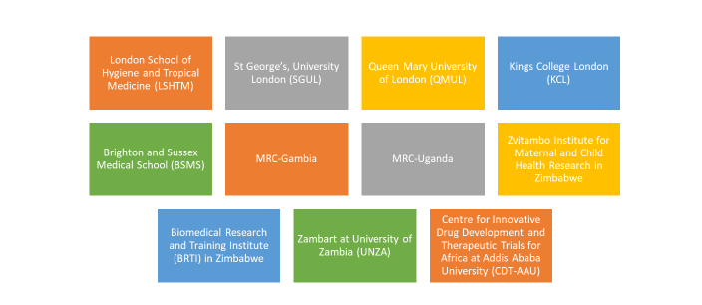
Collaborative partnership:

Slide 11
Overview of the Programme:
Wellcome Trust funded programme: 25 (3-year) PhD fellowships (5/year)
Open to UK/Republic of Ireland registered health professionals
Fellows will register at one of the partner UK Institutions (UKI)
Fellows will be based at an African Partner Institution (API) for 18-24 months

Slide 12
Overview of the Programme:
Research focus:
Health needs of sub-Saharan Africa
Interdisciplinary (rather than exclusively biomedical) research
Research culture:
Wellcome Trust: A culture that is creative, inclusive and honest.
Transformation of Research Culture and improving
Equity, Diversity & Inclusion (EDI) central to programme’s aim

Slide 13
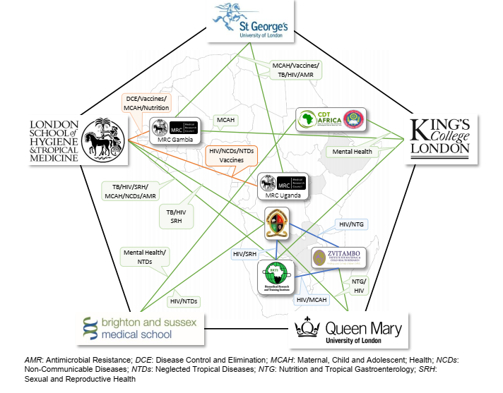
How CREATE differs from previous programme(s):
Defined 6 API with 5 UKI
Modified recruitment process
Joint API and UKI supervision
Training & cohort activities
Research culture and EDI focus
Formal monitoring of fellows/impact
2-level programme oversight

Slide 14
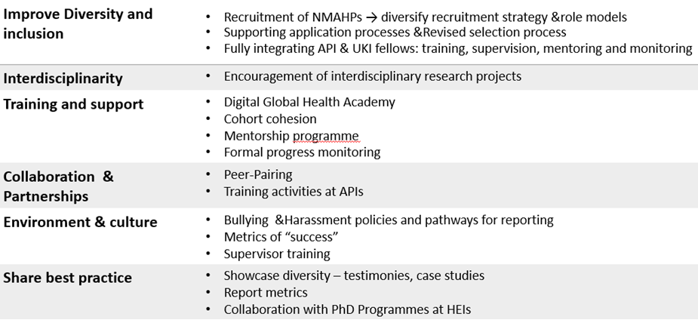
EDI and research culture roadmap:

Slide 15
THEME | TRAINING COMPONENTS
Conducting research effectively | Project / Data / Financial Management Working in resource-limited settings
Enterprise and leadership | Research Leadership Programme Balancing clinical and academic careers Cross-disciplinary working
Contribution to Society | Research for Impact Public Engagement & community partnerships Engaging policy makers Open Access, Research commercialisation & IPR
Transforming Research culture | Teaching, supervising & mentoring Research Integrity: Beyond ethical approvals Bullying and Harassment Personal effectiveness
Global citizenship | Decolonising Global Health Cultural Hegemony Global Health Governance
Digital Global Health Academy:
Modular, participatory programme
To integrate into core doctoral training across institutions
Rolling programme
Across UKI & APIs

Slide 16
API vs UKI fellows/Institutions:
Registration at UKIs or APIs
Funding for research through existing research platforms
UKI commitment: Fee waivers/Varied amount committed per fellow
Access to UKI Resources
Integrated into cohort- same training & support activities & mentorship
Monitoring of progress by PMG

Slide 17
Presentation:
Katherine Barrett: Fellowship lifecycle

Slide 18
CREATE PhD Fellowship:
3 year fellowship
Up to 24 months at API including:
  Biomedical Research and Training Institute (Zimbabwe), CDT-Africa (Ethiopia), MRC-Gambia, MRC-UVRI LSHTM Uganda, Zambart (Zambia), Zvitambo (Zimbabwe)
Registration at UKI including:
  London School of Hygiene and Tropical Medicine, St George’s University of London, Kings College London, Queen Mary’s University of London, Brighton and Sussex Medical School

Slide 19
Overarching structure of CREATE PhD Fellowship:
1. Application (Sept – Nov, Stage 1 / Dec – April, Stage 2)
2. Offer (May)
3. People are required to take up their fellowship within 12 months of the award being made
4. Induction/onboarding
5. Upgrading at end of 1st year
6. Viva at end of 3rd year
Variations: no-cost extension / part-time option

Slide 20
Fellowship supports and resources:
Funded by Wellcome – including PhD fees, salary, overseas allowances, research costs, travel and conferences/training
Individually supported by 2/3 supervisors, as well as mentor (optional)
Access to UKI/API training and research resources
Member of the ‘Digital Global Health Academy’ – training and resources tailored to fellowship
Part of wider cohort of CREATE PhD fellows and other Wellcome-funded fellows

Slide 21
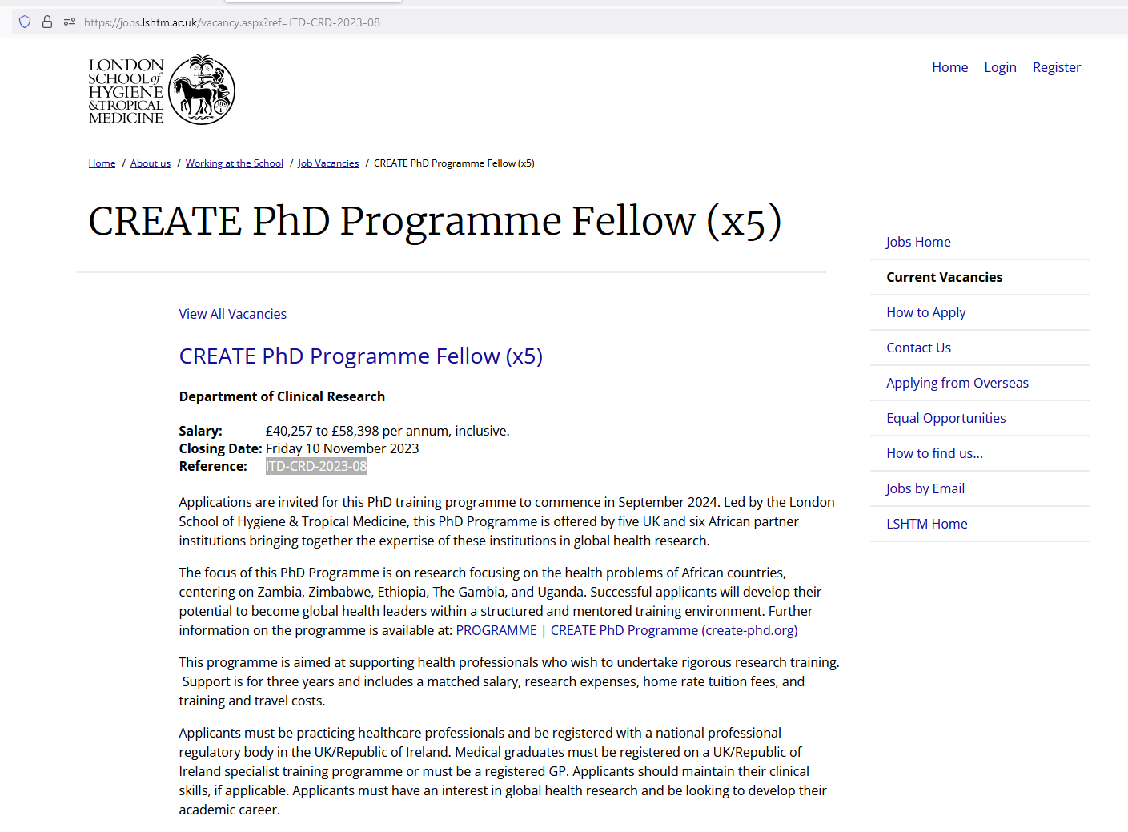
Fellowship application:
2 stage application process
1st stage – submit online application by 8th November 2024
www.jobs.lshtm.ac.uk
Reference - ITD-CRD-2024-09
Person specification
We welcome applications from individuals, regardless of their background, who have the scientific rigour, drive and ambition to carry out world-class research that focuses on issues of public health importance in Africa.

Slide 22
Fellowship application - eligibility:
Healthcare professionals eligible to apply include: art therapists, chiropodists/podiatrists, chiropractors, clinical psychologists, dental hygienists, dental nurses, dental therapists, dentists, dieticians, drama therapists, health visitors, healthcare scientists (in life sciences, physiological sciences, physical sciences and biomechanical engineering, and bioinformatics), medical graduates, midwives, music therapists, non-medical public health specialists, nurses, occupational therapists, operating department practitioners, optometrists and dispensing opticians, orthoptists, osteopaths, paramedics, pharmacists, pharmacy technicians, physiotherapists, practitioner psychologists, prosthetists and orthotists, radiographers, social workers, speech and language therapists, vets, physician assistants.
Applicants should hold full registration with UK professional regulatory bodies (such as the General Medical Council, Nursing and Midwifery Council, Health and Care Professions Council, General Optical Council, General Pharmaceutical Council, General Dental Council and others). All applicants must have completed their undergraduate degree and be registered with the relevant health professional regulatory bodies. Those who have provisional registration or are pre-registration are not eligible to apply. Non-medical healthcare professionals need to have at least 1 year of clinical practice.
Applicants should be eligible to work in the UK and qualify for home or UK-level fees.

Slide 23
Fellowship application:
2nd stage – shortlisted candidates will receive notice by mid-December 2024
Documentation by 18th March 2025 including:
1) A project details form
2) A detailed budget
3) Endorsement of application and budget from your proposed host UK and African Institutions
[A webinar for shortlisted candidates will be scheduled for January 2025 with further information]
Interviews in w/c May 12th 2025
Entry in 2025/2026 (i.e. from September 2025 onwards, within 12 months of the award being made in May)

Slide 24
Fellowship application:
Salaries should be requested according to experience on the appropriate clinical salary scale, including London weighting if relevant. Typically, consultant level salaries and NHS salaries above Band 7 will not be funded, if this issue arises, this should be discussed individually with the Programme Manager.
Routine clinical work (not related to research) should be limited to no more than 8 hours a week (2 clinical sessions) full-time equivalent (FTE) (16 hours for craft specialities FTE, 4 clinical sessions) during the fellowship and the host institution must provide a signed statement agreeing to this restriction. Fellows working clinically or undertaking patient-facing research in the country where they are conducting their PhD research must ensure that they are registered with the appropriate health professional regulatory body, and are undertaking appropriate continuing professional education to maintain their registration.
Projects must demonstrate a clear relevance to the main aim of the CREATE Programme.
An unsuccessful candidate can reapply once, but should seek advice from the Programme Director prior to considering reapplication.

Slide 25
Fellowship application – next steps:
How to apply
Applications must be received through the online LSHTM application system via http://jobs.lshtm.ac.uk by 23.59 hours on Friday 8th November 2024. No applications received after the deadline will be accepted.
The application needs to contain the following elements:
Application form
Supporting letter from academic referee
Completed Equal Opportunities Monitoring Form
The fellowship application is a two-stage process. The initial application assesses your career history to date, your achievements in research to date, your experience of working in low- and middle-income countries (LMICs), your motivation to enrol in this doctoral training programme and a brief outline of your ideas for a PhD. It is not expected that you have identified a definite PhD supervisor and developed a specific project by this stage, although it would be expected that you have some broad ideas for your research project, potential supervisory team, UK institution and African Partner Institution.

Slide 26
Presentation:
Priscilla Harries: how to submit a quality application.

Slide 27



Person
Place
Project

Slide 28
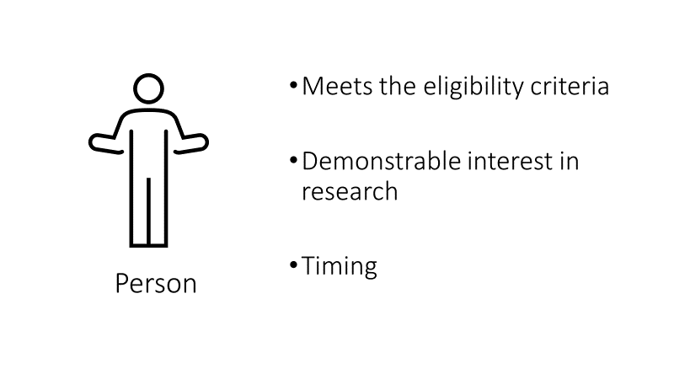

Slide 29
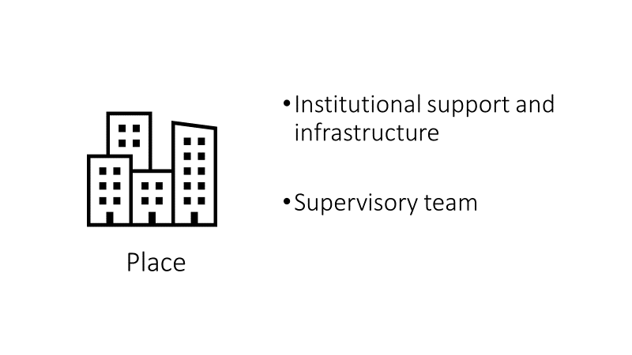

Slide 30
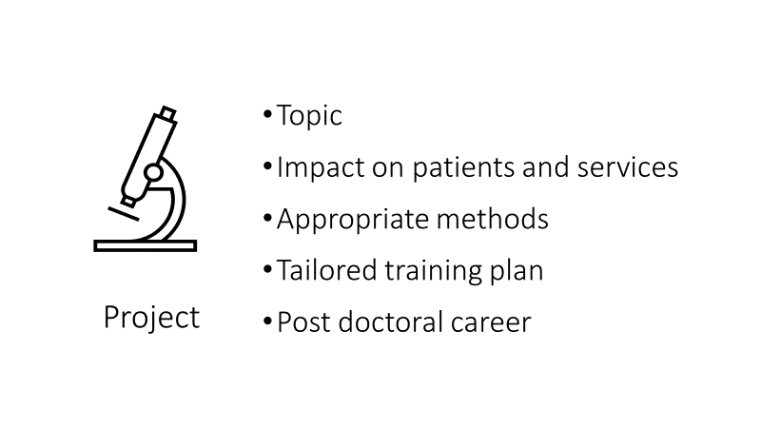

Slide 31
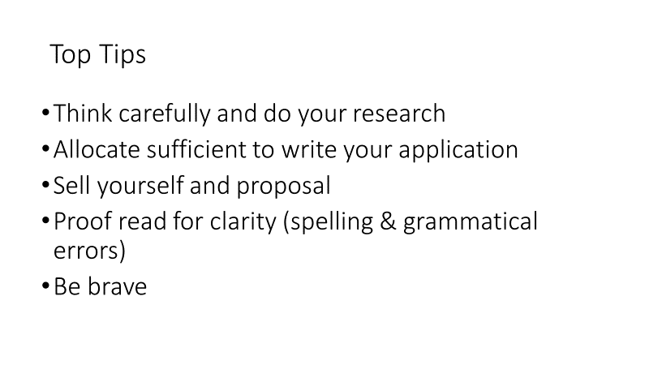

Slide 32
Presentation
Sarah Sturrock and Josie Prynn: perspective from current fellows.

Slide 33
CREATE Fellow Perspective
Dr Josie Prynn
King’s College London, MRC/UVRI & LSHTM Uganda Research Unit
Geriatric Medicine SpR

Slide 34
Overview:
Part 1: Is this the right option for me?
Part 2: Ok I’m keen, what should I be considering right now?

Slide 35
Is this the right option for me?
HCP registered with professional body in UK/ROI
For medics: Be in specialist training, or a GP
Shown commitment and aptitude for a career in global health research
Do I meet the person specification?

Slide 36
Is this the right option for me?
18 months – 2 years working overseas
Impact on personal life
Impact on family
Do I meet the person specification?
Living and working abroad: is it for me?

Slide 37
Is this the right option for me?
Do I meet the person specification?
Living and working abroad: is it for me?
Changing landscape in Global Health (fast but too slow)
Equitable partnership

Slide 38
What to consider: person – place - project
Supervisor + location
  This is very important
  Ask people who work with / are supervised by them
Project:
  Worth time investment to get good
  Feasibility
  Consider the pitfalls and address them
  Speak to anyone and everyone
  Think about your own training needs
If at first you don’t succeed – do try again

Slide 39
Imposter syndrome
Implies you don’t have a right to be here – you do!
Implies this is pathological
Feeling nervous about a new application / position / role is normal
Particularly if you are from an under-represented group
It doesn’t mean you’re not awesome and the right person to be there
“ “imposter” brings a tinge of criminal fraudulence to the feeling of being unsure or anxious about joining a new team or learning a new skill” – Tulshyan and Burey, Harvard Business Review 2021

Slide 40
Be kind to yourself

Slide 41
Moderated Q&A:
Please type questions to the hosts
We will group by theme
Kindly note that we may be unable to respond to all within the timeframe

Slide 42
Follow-up:
Please feel welcome to send questions for the panel afterwards via create-phd@lshtm.ac.uk
Portions of this webinar will be available for viewing on the www.create-phd.org website after this event.

