Slide 1


Slide 2

CREATE PhD Stage 2 UK fellowship Applications
Webinar
Friday 7th February 2025
13:00-14:00 GMT

Slide 3
Panel:
Chair – Prof Gail Davey (EDI lead) – BSMS
Prof Andrew Prendergast – QMUL
Dr Rebecca Nightingale - LSTM
Dr Sam Gnanapragasam(Current UK fellow) - KCL/BRTI (Zimbabwe)
Ms Lydia Davidson(Current UK fellow) – LSHTM/BRTI (Zimbabwe)
Ms Katherine Barrett (Programme Manager) – LSHTM

Slide 4
Purpose:
Information session about the Stage 2 UK fellowship application process. Including the documents required for submission (by Tuesday 18th March 2025) and the interview (on Tuesday 13th / Wednesday 14th May 2025).

Slide 5
Format:
Presentations on the Stage 2 application documents, how to prepare a winning application, perspectives from current fellows.
A moderated general Q&A
A NMAHP specific Q&A

Slide 6
Follow-up:
Please feel welcome to send questions for the panel afterwards via create-phd@lshtm.ac.uk

Slide 7
Housekeeping:
This session will be recorded and will be made available afterwards
Only nominated panelists can be seen, heard or screen share
The audiences’ mics & videos are turned off
The Q&A function is available in this session – please ensure messages are respectful and in line with LSHTM’s values
Questions will be answered after all panelists’ presentations

Slide 8
Presentation:
Katherine Barrett:
Stage 2 application documents.

Slide 9
Recap of the CREATE PhD Programme:
Wellcome Trust funded programme: 25 PhD fellowships (5/year)
Open to UK/Republic of Ireland registered health professionals
Fellows will register at one of the partner UK Institutions (UKI)
Fellows will be based at an African Partner Institution (API) for 18-24 months
Programme will recruit & support matched 25 African fellows from the APIs

Slide 10












CREATE PhD Programme partners recap:
City University and St George’s University merged in August 2024 to become City St George’s, University of London

Slide 11
Stage 1 application closed: 8th November 2024
Stage 2 application closes: 18th March 2025
Assessment of written application by external review panel
Interviews: 13th/14th May 2025
Appointment of fellowships by: 19th May 2023
Application process:

Slide 12
Stage 2 application:
Due for submission by Tuesday 18th March 2025
Focus on the written Stage 2 project submission documentation
Documents include:
  Project details form
  Budget
  Institutional authorization

Slide 13
Stage 2 application:
Before you start
You need to identify a supervisor and a UK host institution (UKI).
In addition, you need to identify an appropriate African Partner Institution (API) and an African supervisor. Your supervisors will support you to develop your project proposal.
At both UK and African institutions, you need a Sponsor: this is a senior academic (usually head of department, or head of institute) who will provide assurances that the institution is willing to host you and is a suitable place to undertake the project you are proposing.
Ensure at an early stage that your supervisor, sponsor and collaborators are able to confirm their contribution to the application.

Slide 14
Stage 2 application:
Before you start
Your UK host institution must be one of the partners in the programme: LSHTM, BSMS, KCL, QMUL and CSGUL.
This is the institution where you will register your PhD and this institution will sponsor your PhD, administer your grant and make available the requisite training you need for your fellowship.
You must have:
• A sponsor who holds an established post (or an honorary academic appointment) at your sponsoring organisation and is committed to helping you achieve your career aspirations and guarantees the resources and locations.
• A supervisor who will offer you advice about your application and scientific guidance throughout the fellowship. Your sponsor and supervisor must hold an employment contract with your host institution.

Slide 15
Stage 2 application:
Before you start
Your African Partner Institution (API) must be one of the programme partners:
• MRC/UVRI & LSHTM Uganda Research Unit, Uganda
• MRC Gambia, The Gambia
• Center for Innovative Drug Development and Therapeutic Trials for Africa (CDT-Africa), Addis Ababa University, Ethiopia
• Zambart, Zambia
• Biomedical Research and Training Institute, Zimbabwe
• Zvitambo Institute for Maternal and Child Health Research, Zimbabwe
This is the institution where you will be based when you are in Africa conducting your research. The institution will administer your overseas research costs and make available the requisite support you need to conduct your research. You must have a sponsor who holds an established post at the API who will guarantee the resources you need.

Slide 16
Stage 2 application:
Guidance
  Stage 2 Guidance document
  FAQs (on website)
  UK institution and African partner institution support (supervisors, sponsors)
  CREATE PhD Programme management support – create-phd@lshtm.ac.uk
    Budget guidance
    Wellcome policy and regulations

Slide 17
Stage 2 application:
Guidance
  Programme Management Group (PMG) mentors – 1 UKI and 1 API
    For the written application development –
      The PMG mentor will help the candidate to identify appropriate UKI and API supervisors
      The PMG mentor may be able to suggest specific individuals and/or other experts in the field that they are aware of who may serve as co-supervisors or provide further advice on the application.
      Furthermore, the PMG mentor may offer the candidate a review of their Stage 2 project details document and/or budget.
    For the interviews –
      The PMG mentor may offer to provide a mock interview themselves, if this is feasible.

Slide 18
Stage 2 application submission:
1. Project details form
Completion of:
Institutional details
Supervisor and sponsor
Clinical status and duties
Research training
Research supervision
  Supervisory plan
  Supervisor training

Slide 19
Stage 2 application submission:
1. Project details form
Completion of:
Research proposal
Public engagement
Impact
Collaborators

Slide 20
Stage 2 application submission:
1. Project details form
Research focus
    The area of research should focus on health and be of relevance to Africa.
    We particularly encourage interdisciplinary projects (rather than exclusively biomedical)
You should have an appropriate supervisory team to support such a project.
Indicate the broader aspects around research e.g. engagement and impact
Provide substantiation for the research training to be undertaken

Slide 21
Stage 2 application submission:
2. Budget
The fellowship will provide a full salary, research costs and overseas allowances for when you are based at the API
Please consult your UK host institution administrator for advice re: PhD fees and costing your salary and allowances. The cost of full study fees should be included in your budget. The CREATE PhD Programme Manager can also provide you with support re: preparing the budget.
Guidance about allowable costs is provided in the Stage 2 Guidance document, including breakdown of costs for:
  1. Fellow’s salary
  2. Home rate PhD tuition fees
  3. Overseas allowances
  4. Research expenses
  5. Travel costs (including collaborative travel)
  6. Training costs

Slide 22
Stage 2 application submission:
2. Budget
Salaries should be requested according to experience on the appropriate salary scale, including London weighting if relevant. If questions or issues arise, this should be discussed individually with the CREATE PhD Programme Manager.
Justification of costs may need to be provided, if questions arise during the assessment by external panel. You may need to provide assurances from your host UK institution that the budget has been fully costed and approved, with relevant signatures from your head of faculty/institute (or equivalent) and research management office/operations team.

Slide 23
Stage 2 application submission:
3. Institutional authorisation form
You will register your PhD at one of the UK institutions (UKI - your host institution).
You are expected to spend at least 12 and up to 18 months of your PhD based at one of the African Partner Institutions (APIs) from where you will conduct your research.
The institutional authorisation form ensures your application and budget are authorised by both the proposed UKI and API before submission
This form is signed by your UKI sponsor and API sponsor - both must be from the institutions where you are formally based
A sponsor’s role is to guarantee you the facilities, training, space etc at the partner institution and therefore it is usually a senior member of the institution. They may or may not necessarily be involved in the research (unlike the supervisor) but can serve as a guarantor.
Ensure you have checked the timelines and internal institutional requirements for your UKI and API for e.g. internal research finance sign-off. Some institutions require an ‘intention to bid for funding’ or ‘notification of funding’ application. This will be in a local format required by your institution.

Slide 24
Assessment of written application by external review panel:
Broadly, the external review panel’s assessment will look at:
Track record and aptitude for a career as a clinical academic
The scientific merit, feasibility and potential impact of your proposed project
Plans for research training
Suitability of your sponsor, supervisor and training environment
The external review panel (up to 4 independent reviewers) score each written application against a schematic with 8 domains.

Slide 25
Assessment of written application by external review panel:
Importance of proposed research question to global health research
Clarity of research question / hypothesis
Appropriateness of research methods; justification and integration of disciplinary elements.
Quality of research methods
Appropriateness of project as a PhD training experience
Suitability of training plans
Appropriateness of supervisory team
Completeness/appropriateness of budget

Slide 26
Interview:
Review and scoring of Stage 2 Application prior to interview by external reviewers
Scores received by interview selection panel
Interview format:
25 minutes total
5 minutes presentation: maximum 4 slides
1st slide: “Why this doctoral opportunity is the best next step for my career”
Remaining slides: present and ‘sell’ your project

Slide 27
Interview:
May 13th/14th 2025
In person – LSHTM Keppel Street premises
Interview panel:
  Programme Equity, Diversity and Inclusion Lead: Professor Gail Davey
  Chair: Professor Richard Harding
  External to the Programme Directorship
  Multidisciplinary research & health professional expertise
  Representation from African and UK Institutions

Slide 28
Interview:
Interviewers will:
At an interview, the expectation is that candidates are assessed solely on their credentials and experiences and how well they meet the person specification from the job description.
Assess the applicant’s answers against the criteria for the role. Avoid comparing applicants against each other, unless for the purpose of calibration.
Interview culture:
A culture that is creative, inclusive and honest.
Transformation of Research Culture and improving
Equity, Diversity & Inclusion (EDI) central to programme’s aim

Slide 29
Assessment of Interview:
Depth of understanding of the background to the proposed research question and methods
Ownership of the proposed research
Critical analysis of your proposed research
Likelihood of a “successful fellowship”

Slide 30
Interview outcomes and fellowship appointment:
Outcomes will be communicated by 19th May 2025
Typically up to 5 fellowships are appointed each year (with some discretion)
Entry start dates for 2025/2026 (i.e. from September 2025 onwards) should be within 12 months after fellowship offer

Slide 31
Panel discussion:
Andrew Prendergast, Gail Davey and Rebecca Nightingale: What makes a winning application – top tips

Slide 32
Andrew Prendergast:
What skills would you would like to acquire - how these are embedded within your project?
It’s a PhD – be collaborative and honest in what you can achieve
Gail Davey:
Acknowledge your role in the wider CREATE scheme
Rehearse, rehearse, rehearse.
Rebecca Nightingale:
Why your topic is important enough to be funded?
Convince the team that your project is feasible: can it be done and are you the right person to do it?

Slide 33
Panel presentation:
Lydia Davidson and Sam Gnanapragasam: Perspectives from current fellows

Slide 34
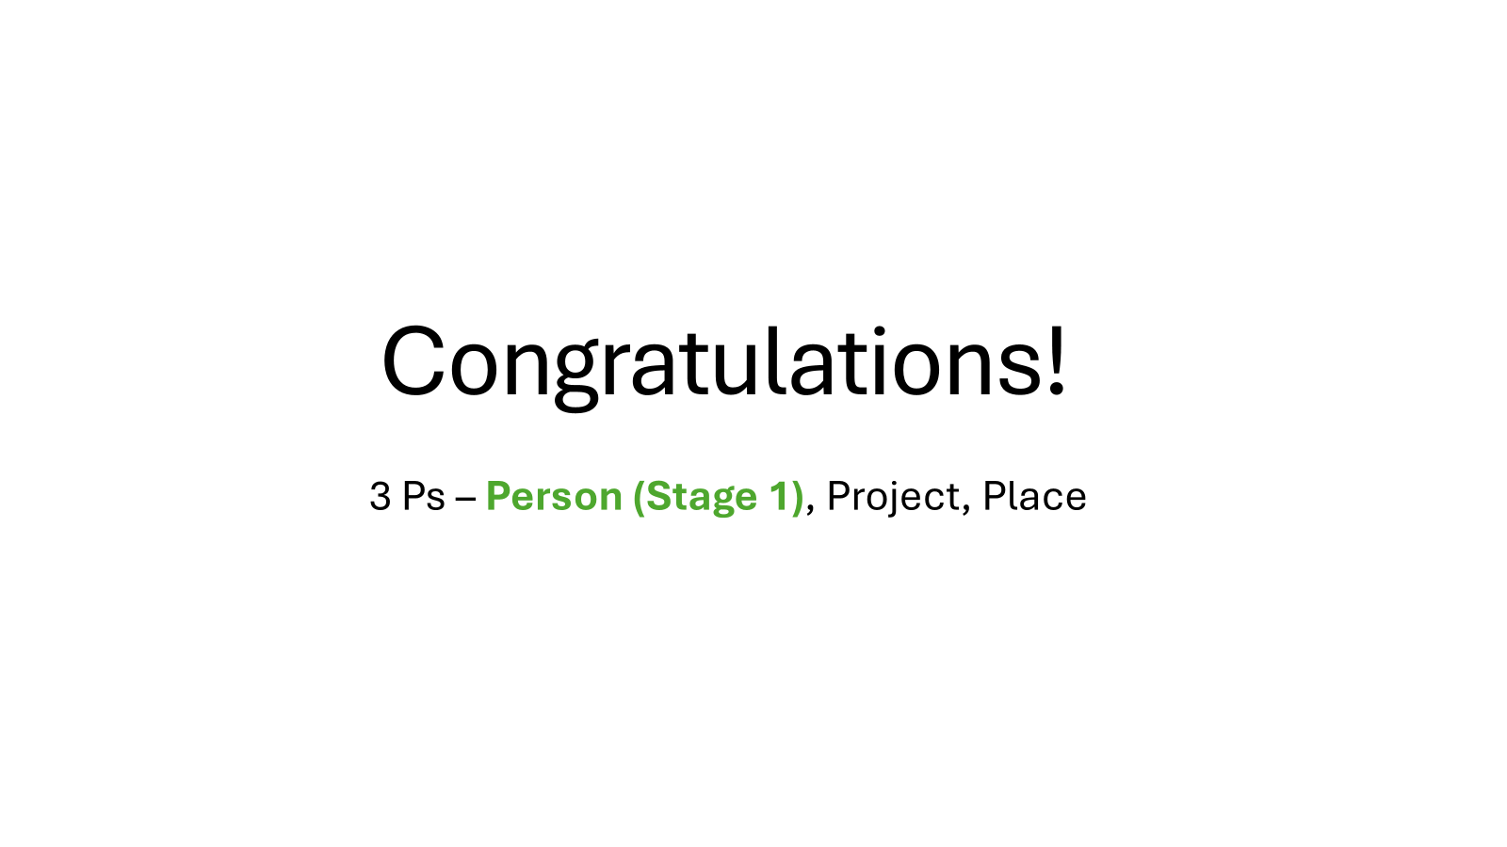

Slide 35
What we’ll be talking about
Establishing your team
Building your project
The Application
The Budget
The Interview
Question & Answer

Slide 36
Establishing your research team
Paired with institutional leads to guide you
  Schedule meetings
  Ask lots of questions
  Make use of their networks
  Discuss your initial ideas – do you have a concept/already have a project?
Build your own network
  Great opportunity to meet new people
  Cast a wide net across UK/African CREATE Institutions:
    Potential supervisors
    Research setting
    Place
  Email etiquette
  Build in-country relationships, could include trip to visit

Slide 37
Building your project
Narrow down your supervisory team
  Area of interest/question, methodology and relationship
  The most responsive individuals probably have more time – less responsive individuals may make better advisors/secondary supervisors
  You can have cross-institutional supervision
Narrow down your project idea
  Start writing
  Concept note/two paragraphs
  Get feedback
  Change is normal

Slide 38
Application Form
  Standardised sections for any project
    Ask your supervisors for templates: Data Management, Material Transfer Agreements
  Use learning needs to devise a training schedule
    Masters’ modules? Training courses? How do they relate to your objectives?
  The Project Proposal
    “will this lead to new knowledge?”
    3 objectives, interrelated but sufficiently independent that you can complete a PhD if one (or two!) objective(s) falls through
    A delicate balance between being precise (grounded in existing evidence) and vague (allowing you flexibility to explore)
    Feasibility is a key consideration
    Get writing & get feedback (submit when you’re on ~version +++)

Slide 39
The Budget
Three: UK Expenditure, Overseas Expenditure, Overseas Allowance
Start early, and work on it alongside the application
Pragmatic decisions – need approvals
‘Go Big’
Engage with those with budget experience
  Christina Albertsen (LSHTM) – other UK institutions will have their own experts
  API – there will be a budgetary contact who can assist you
  Some things are always expensive e.g. reagents/lab costs – consider whether you can apply for extra grant funding later in your PhD so you can commit more costs to personnel (e.g. research nurse)
  Visas/work permits/licensing costs are all separate to research allowance

Slide 40
The Interview
Read the proposal feedback
  This thorough review is practically an interview-question guide
Interview format
Practice mock interviews
  A hard and “nasty” one
  A helpful and detailed one
Time yourself, use a mirror, smile
Practice the usual suspects
  “what kind of researcher do you want to be?”

Slide 41
Final Thought and Q&As
  Intense period…
  …period of development
  Speak to lots and lots of people – that are appropriate for what you need in your role
  Changed proposal five times – find and sell the story
  Identify your own particular skills or attributes and show them
  Things can change after you start

Slide 42
Q&A and Thank you to our panel
Chair -Prof Gail Davey (EDI lead) – BSMS
Prof Andrew Prendergast – QMUL
Dr Rebecca Nightingale - LSTM
Dr Sam Gnanapragasam(Current UK fellow) - KCL/BRTI (Zimbabwe)
Ms Lydia Davidson(Current UK fellow) – LSHTM/BRTI (Zimbabwe)
Ms Katherine Barrett (Programme Manager) – LSHTM

Slide 43
Follow-up:
Please feel welcome to send questions for the panel afterwards via create-phd@lshtm.ac.uk
Portions of this webinar will be available for viewing on the www.create-phd.org website after this event.

